Slide 1
Zomato Restaurant Analysis
-R.Mohanakanna

Slide 2
Introduction and Objectives
Zomato, a renowned name in the culinary world, is launching a revolutionary restaurant project aimed at enhancing dining experiences globally.
Leveraging cutting-edge technology and culinary expertise, Zomato is set to redefine the restaurant landscape, offering unparalleled convenience and satisfaction.
To identify potential areas for opening new restaurants with lesser competition.
To identify the market trends in those areas.

Slide 3
Data Overview
Restaurant ID: Unique identifier for each restaurant.
Restaurant Name: The name of the restaurant.
CountryCode: Country code of the location where the restaurant is situated.
City: The city where the restaurant is located.
Address: The specific address of the restaurant.
Locality: The locality or neighborhood where the restaurant is situated.
Locality Verbose: Detailed information about the locality.
Longitude: The geographical longitude coordinate of the restaurant.
Latitude: The geographical latitude coordinate of the restaurant.
Cuisines: The type of cuisine offered by the restaurant.
Currency: The currency used for transactions in the restaurant.

Slide 4
Data Overview Contd.
Has_Table_booking: Indicates whether the restaurant has a table booking option (Yes/No).
Has_Online_delivery: Indicates whether the restaurant offers online delivery (Yes/No).
Is_delivering_now: Indicates whether the restaurant is currently delivering (Yes/No).
Switch_to_order_menu: Indicates whether users can switch to the order menu (Yes/No).
Price_range: A numeric value indicating the price range category of the restaurant.
Votes: The number of votes or ratings/(feedback) received by the restaurant.
Average_Cost_for_two: The average cost for two people dining at the restaurant.
Rating: The overall rating of the restaurant is based on user reviews.
Datekey_opening: The date when the restaurant was opened.

Slide 5
Methodology
Data Cleaning: Utilized functions like LEFT() to extract year from date.
Data enrichment: Enhanced the dataset with additional variables like VLOOKUP to cross reference country.
Descriptive Analysis: Employed Pivot Tables for key metrics and identifying the competitor restaurants and top cuisines.
Competitor Analysis: Identifying the competitors in the suggested areas.
Visualisation: Created dynamic charts and dashboard for data representation, enabling interactive data exploration

Slide 6
Analysis of Objective Questions
Global restaurant distribution shows strategic expansion, reflecting diverse markets chosen for growth opportunities
By comparing no of restaurants with each year able to find the growth of competitive risks year wise .
.
Fig. 1.1
Fig. 1.2

Slide 7
Analysis of Objective Questions Contd.
From the comparison in Figure 1.3 found that costlier restaurants are less in India.
COUNTIFS('Raw Data'!D2:D9552,”India”,'Raw Data'!K2:K9552,"=4“. Refer Objectives sheet.
There are 388 restaurants in India in price range of 4.
From the comparison of average of votes in Fig. 1.4 able to identify the feedback rate of the customers.
In this Indonesia have high average no of votes means no of customers rating the restaurants is high
Fig. 1.3
Fig. 1.4

Slide 8
Insights from Subjective Questions
From the fig. 1.1 filter the 10 countries with lesser number of restaurants , easy to compete.
From the fig. 2.1 and fig. 2.2 the country with less dense of restaurants and lower rating are found.
Based on the above conditions countries like Canada, Australia, Singapore and Sri Lanka have lesser competition.
Fig. 2.1
Fig. 2.2

Slide 9
Insights from Subjective Questions
From the fig. 2.3 ratings for the suggested countries are shown.Sri Lanka has higher rating indicates restaurants in that country are generally meeting customer satisfaction and possibly intense competition among the four countries.
From the fig. 2.4. Sri Lanka have Lesser expenditure at 4% so keep financial expenditure low at this countries.
Fig. 2.3
Fig. 2.4

Slide 10
Insights from Subjective Questions
Suitable Cities in the suggested countries are found based on their rating which are less than 3.6 easy to attract customers in that region.
Recommended cities in Australia are Montville, Paynesville, Mayfield, Balingup, Penola, Armidale, Macedon and Flaxton.
Recommended cities in Canada are Consort and Yorkton.
The other countries in the analysis each feature unique cities, which suggests that further analysis may not be necessary

Slide 11
Insights from Subjective Questions
Biggest competitors from the suggested cities and countries are identified by competitors analysis.
Similarly comptitors in other countries are found.
Refer Competitor Analysis Sheet
Fig. 2.5

Slide 12
Insights from Subjective Questions
The selection of cuisines influences restaurant ratings, even when the expenditure remains constant. This indicates that the choice of cuisine plays a significant role in determining customer satisfaction and overall ratings.
Modern Australian, Australian, Mediterranean, Seafood, Pizza, Bar Food are the famous cuisines in Australia.
Italian, Mediterranean, Pizza are the famous Cuisines in Canada
American, Steak, Bakery, Italian are the famous Cuisines in Singapore
Seafood, Juices, Desserts are the top cuisines in Sri Lanka.
Refer: Cuisine Analysis sheet

Slide 13
Insights from Subjective Questions
Restaurants that offer table booking services enjoy a 23.8% higher rating compared to those that do not provide this option.
Restaurants that offer online delivery services tend to have a 19.6% higher rating, but currently, many of them are not providing delivery services
Consequently, there isn't a significant disparity in ratings between restaurants that offer delivery and those that don't.
Conclude that offering table booking services contributes to customer satisfaction

Slide 14
Insights from Subjective Questions
Despite the positive correlation of 0.2454 between the rate of cuisines and ratings, as shown in Fig. 2.6, the weak strength of this correlation indicates that it is challenging to establish a definitive relationship between the rate of cuisines and ratings.
Fig. 2.7 reveals that a significant majority of restaurants fall within the low-price range, while a minimal fraction operates in the high-price segment, indicating a market skew towards affordability.
Fig. 2.6
Fig. 2.7

Slide 15
Strategic Recommendations
Implement Online Table Booking: Offer online table booking services to enhance convenience and attract more customers.
Maintain Medium Food Costs: Keeping food prices moderate can broaden market appeal and increase market size.
Tailor Cuisine Selection: Feature popular cuisines relevant to the location to maximize customer attraction and satisfaction.

Slide 16
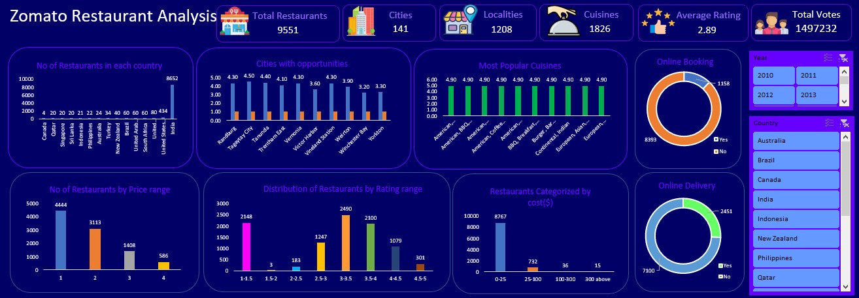
Dashboard and Visualization

Slide 17
Conclusion
In conclusion, our analysis has pinpointed several key factors for successful restaurant expansion, focusing on countries with lower competition, cost-effectiveness, preference for online table booking, and careful selection of cuisines.
By strategically selecting these countries, we can maximize our chances of success and minimize risks.

Slide 18
References
https://docs.google.com/spreadsheets/d/1Hb_paDtRQim1ippetVgd21Tf_7qg528D/edit?usp=sharing&ouid=107028638528398561234&rtpof=true&sd=true

